Slide 1
NY Taxi Data Lake Analytics

Slide 2
Why? What is A use case that HPCC Systems solves?

Slide 3

Credit/Prepaid Card Fraud

Slide 4

CATCH ME IF YOU CAN

Slide 5


MONEY
Money raised for fraud focused companies - > $10BN
Banks Fined – Billions of dollars ~ $500BN
Money Stolen? – Impossible to track

Slide 6
WHY IS IT SO HARD?
1.2BN+
VOLUME
TRANSACTIONS
Data Analysis
SECONDS/MINUTES vs HOURS/DAYS
VELOCITY
180MM+
180+
CARD ACCOUNTS
VARIETY
PROGRAMS

Slide 7

How does HPCC Systems help?
Integrate
Profile
Clean
Augment
Analyze
Deliver
Decreasing Content Volume
Batch Services
Relate &
Big Data
Sources
Profile & Clean
Standardize
Real-time Services
Analyze
Visualization Integration
Increasing Content Quality
Unstructured and Structured Content
HPCC Systems Data Lake
Analysis Applications

Slide 8
The HPCC Systems Components
Big Data
Structured
Unstructured
Semi-structured
Thor cluster
Transformation Engine
ROXIE cluster
Query Engine
Developer
Using VS Code
ECL
Programming Language
Transformation
Query
High Performance Computing Cluster (HPCC)

Slide 9

Scale from Small to Big
In more sophisticated cases, HPCC Systems runs a cluster of thousands of servers which work together to process and deliver big data.
The stack can run on a single laptop or desktop.

Slide 10
Why HPCC Systems?

Slide 11
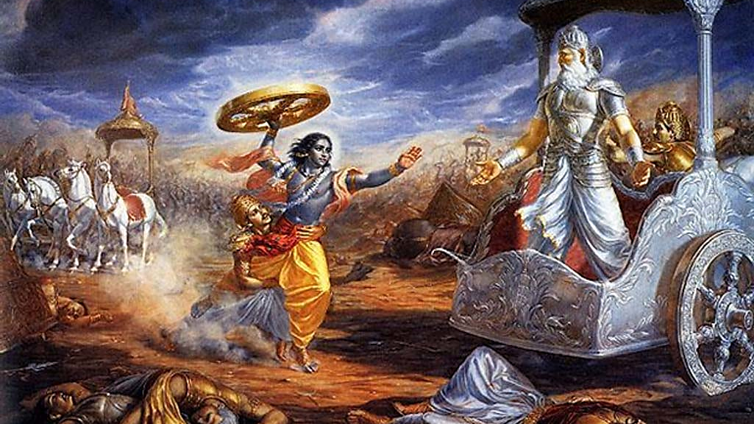

Slide 12
Metrics
Pandavas | Kauravas
5 Brothers | 100 Brothers
Krishna (Did not fight) | Bhishma – The greatest warrior
Smaller army | Karna – Second Greatest warrior
 | Drona – Teacher of all brothers
 | Demons
 | Humungous army

Slide 13

Who won?
Pandavas – 5 brothers

Slide 14


Slide 15
Let us get some practice

Slide 16
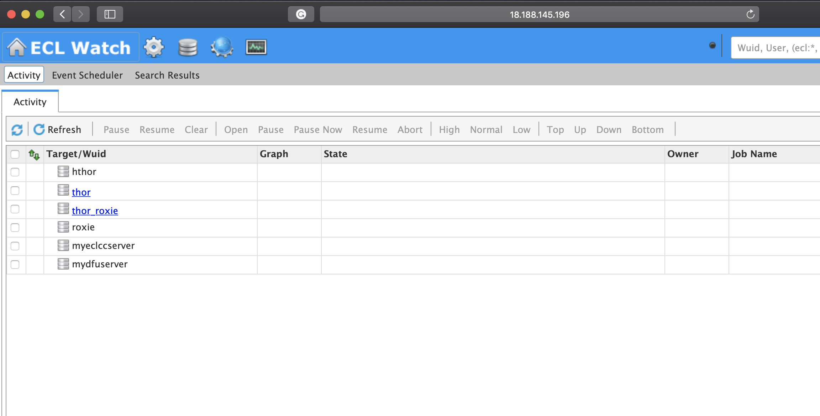
The Cluster
Cluster - http://18.188.145.196:8010/
http://github.com/hpcc-systems/Train

Slide 17
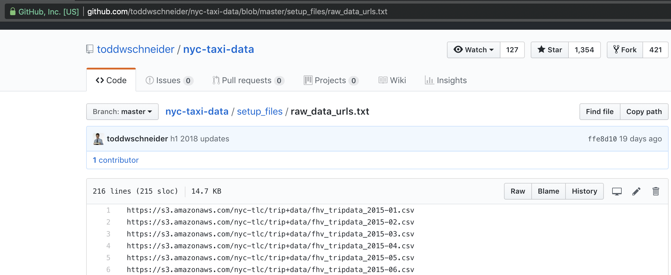
The Data Source
Todd Schneider’s Github
https://github.com/toddwschneider/nyc-taxi-data/blob/master/setup_files/raw_data_urls.txt

Slide 18
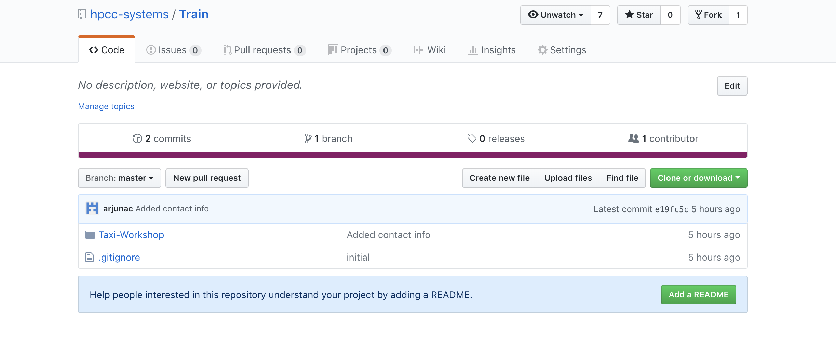
The code and presentation
http://github.com/hpcc-systems/Train

Slide 19
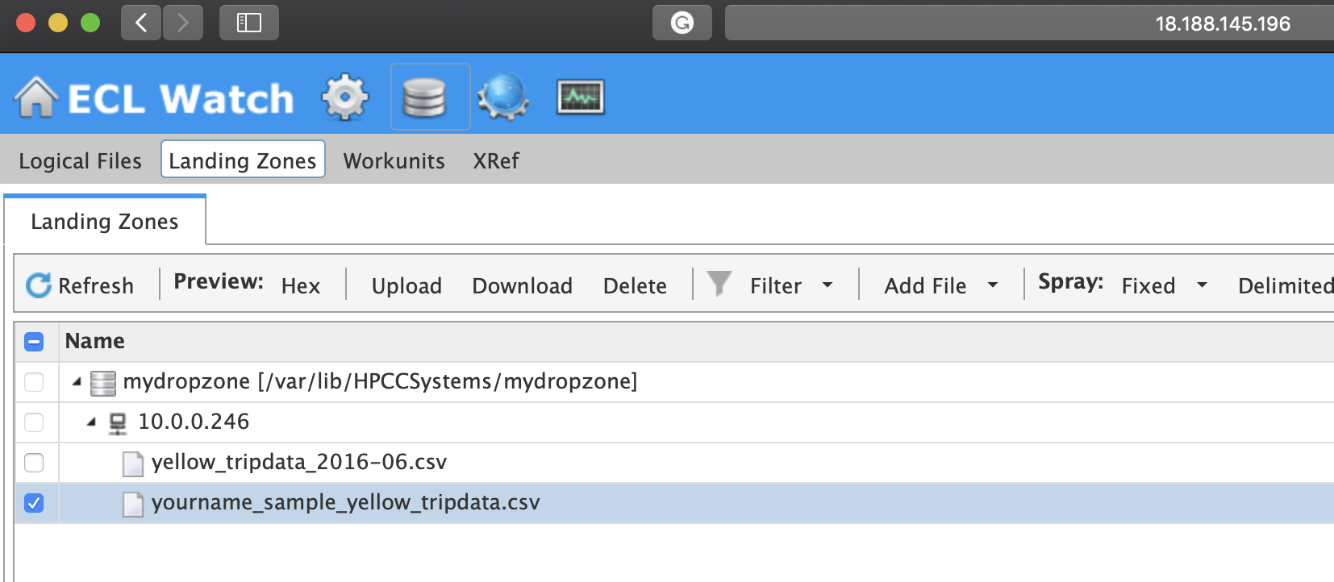
But we will start small
1. Download a sample file to your system
1
2
2. Rename the file to <last-initial><last-name>_sample_yellow_tripdata.csv
Example: achala_sample_yellow_tripdata.csv

Slide 20
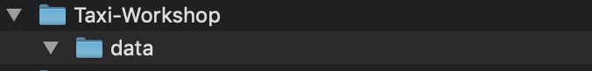
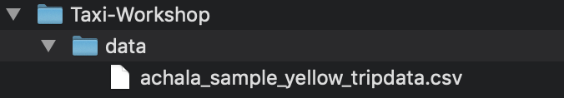
3. Create a local project directory
4. Copy xyz_sample_tripdata.csv to the data folder

Slide 21
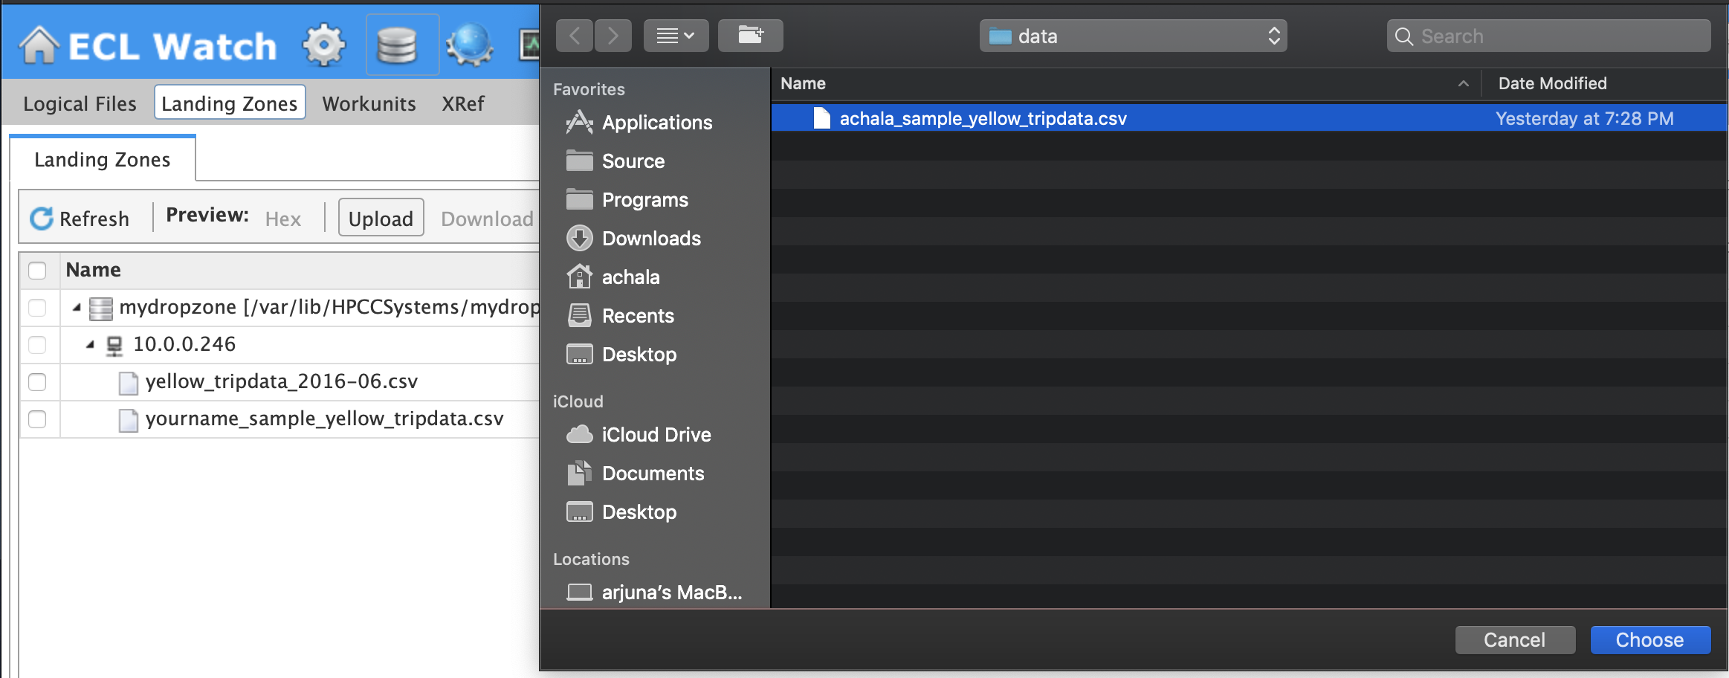
5. Upload the file to the cluster’s landing zone
1
2
3
4

Slide 22
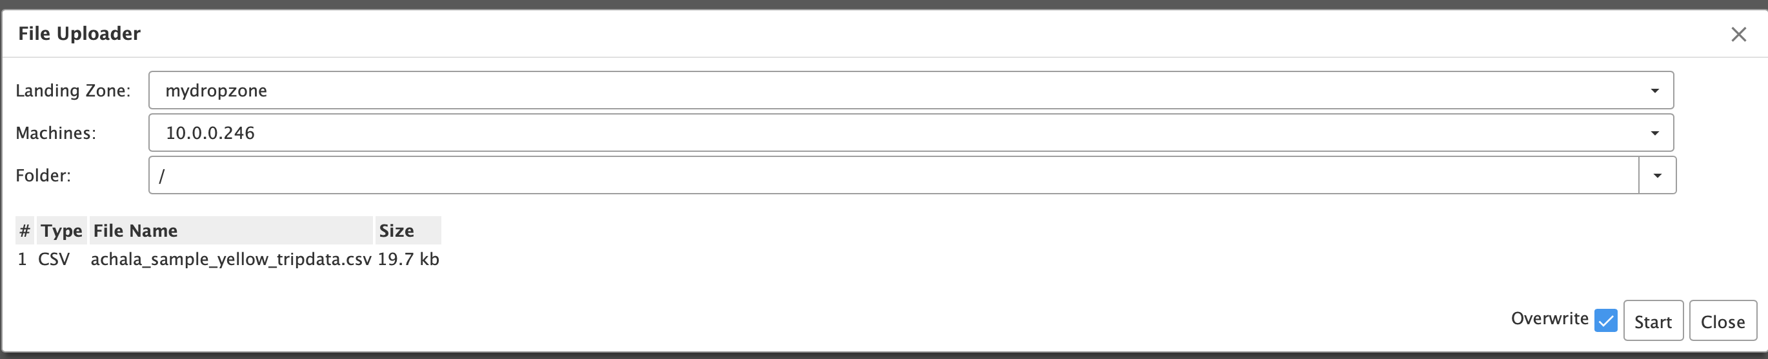
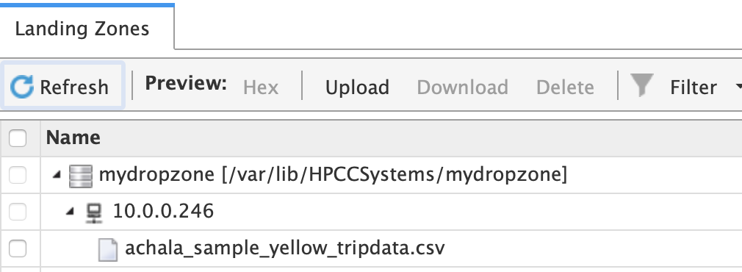
1
! DO
2
3
! Observe: Imported File

Slide 23
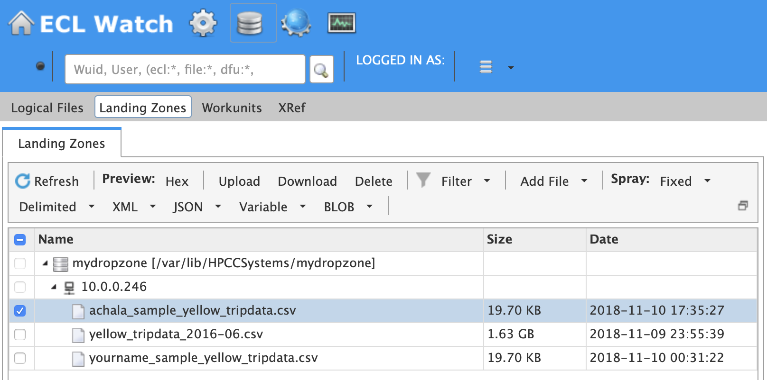
5. Import the file into the cluster
1
! DO
3
2

Slide 24
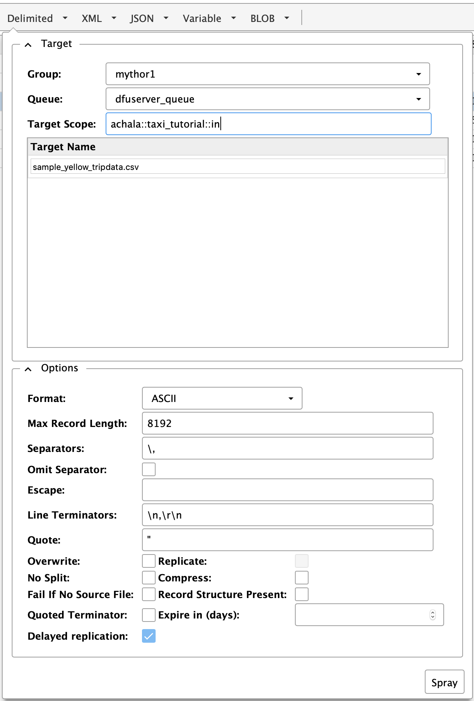
1
2
3
! DO
4

Slide 25
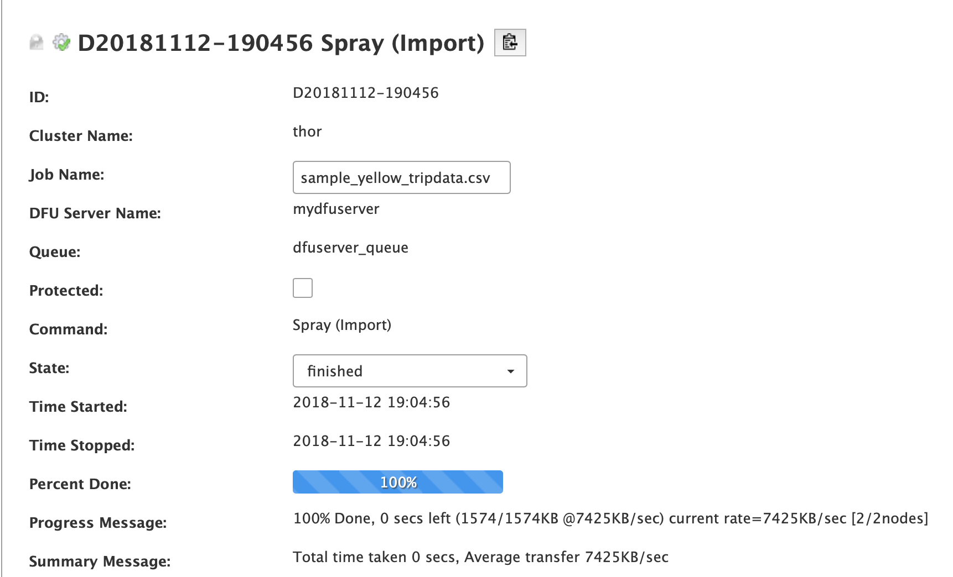
! Observe: OUTPUT 1
Notes:
Explain why source has 1 part and target has 2 parts

Slide 26
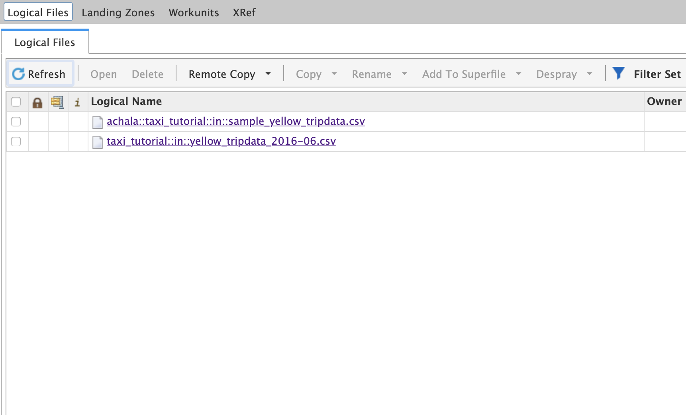
! Observe: OUTPUT 2

Slide 27
Quick check – what have we learnt?
Setup the development environment
Upload a file to the clusters landing zone
Import the data from the landing zone into the cluster

Slide 28
ECL Basics

Slide 29

Prepare coding Environment
1. Create a ECL code directory
2. Add the ecl directory to a VS Code workspace

Slide 30
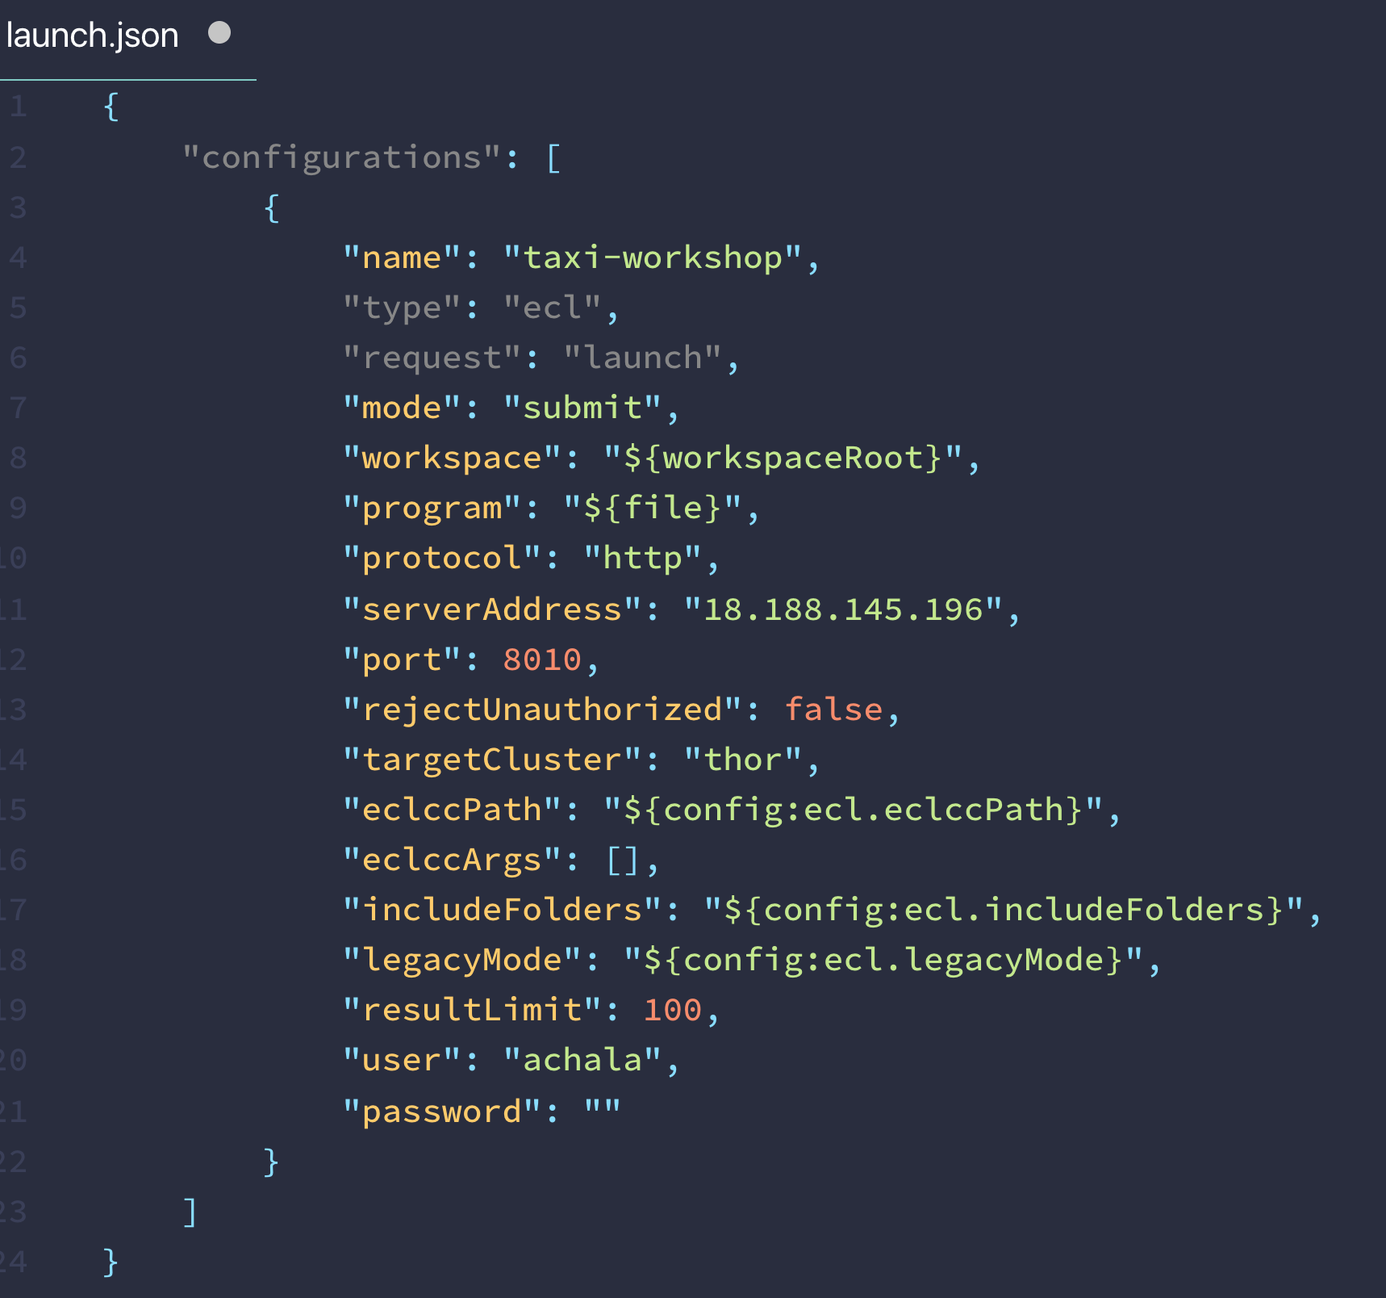
3. Add the ECL Launch Configuration

Slide 31
Read Data
Transform Data
Write Data
Notes:
Describe DATASET, RECORD, OUTPUT

Slide 32
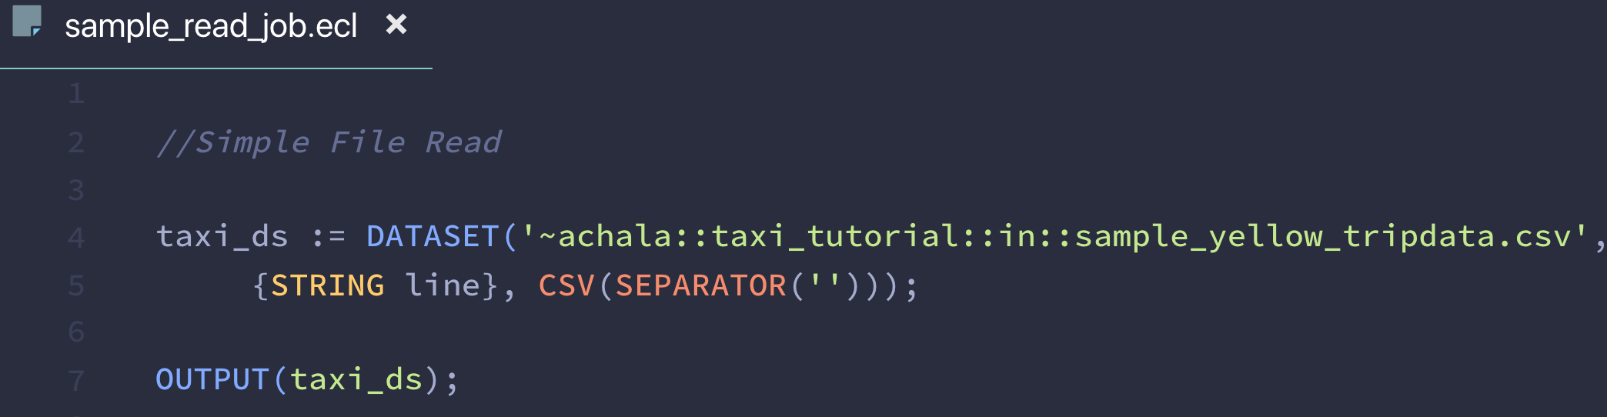
Read DATA

Slide 33
About ECL
ECL is declarative. No Variables, just Declarations
and Actions

Slide 34
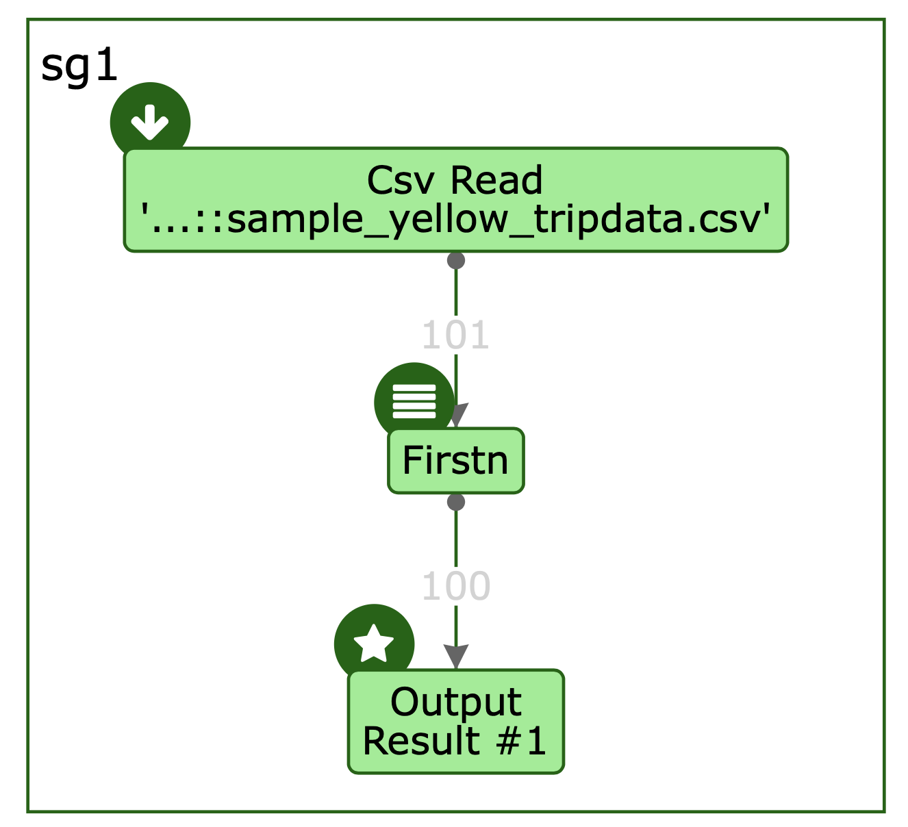
ECL is Optimized to a Dataflow execution graph
The optimizer decided that it was enough to read 101 records and output a 100

Slide 35

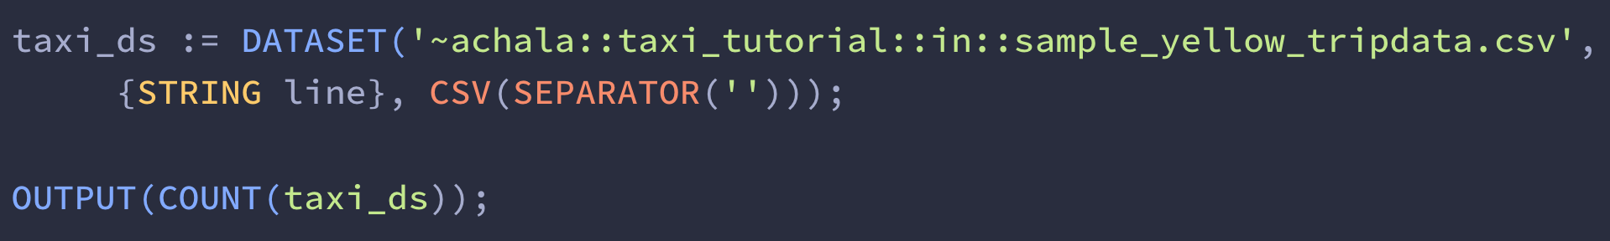
ECL Code is optimized based on NEED
The COUNT indicates to the ECL Optimizer that it needs to read all the records to perform a count

Slide 36
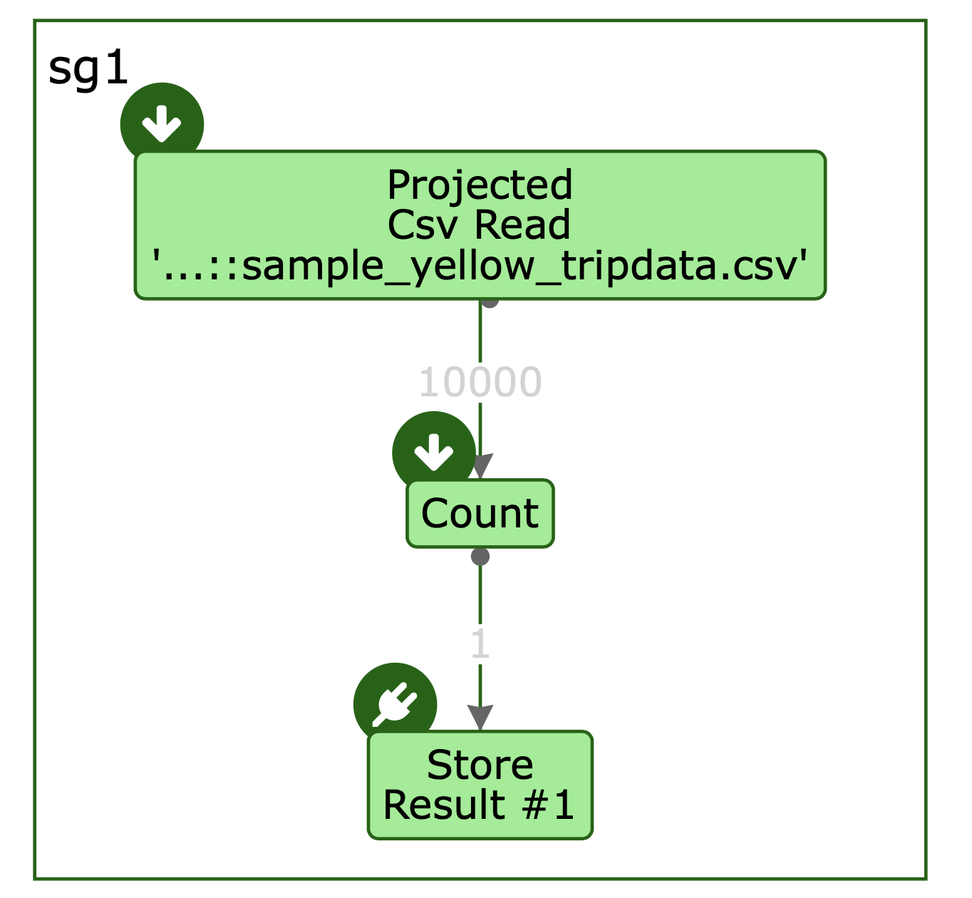
The optimizer creates the dataflow to read all the records in order to perform a COUNT

Slide 37
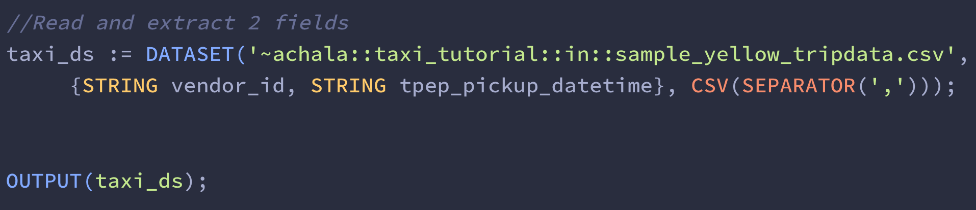
Read and extract fields
Read 2 fields only. An inline RECORD definition
Use a separator

Slide 38
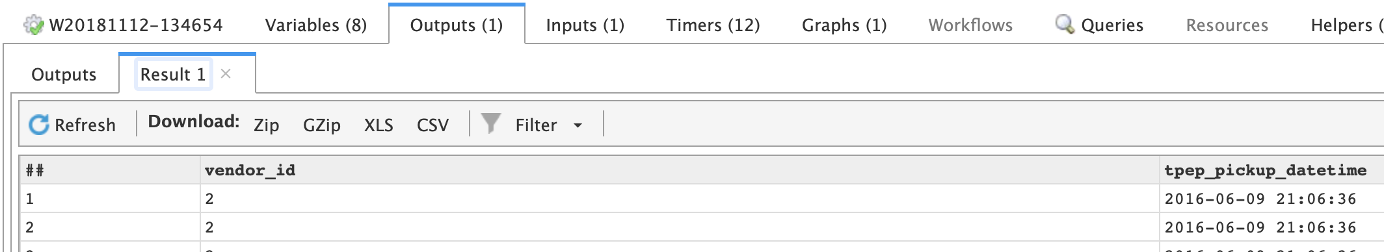
! Observe: Output shows exactly 2 fields

Slide 39
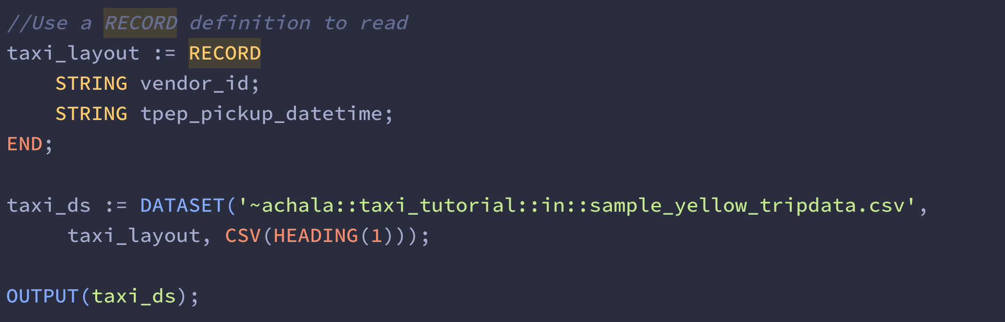
READ AND EXTRACT FIELDS (REUSABLE USING RECORD)
A RECORD definition
The first record in the file is contains the titles for the fields, we can ignore it.

Slide 40
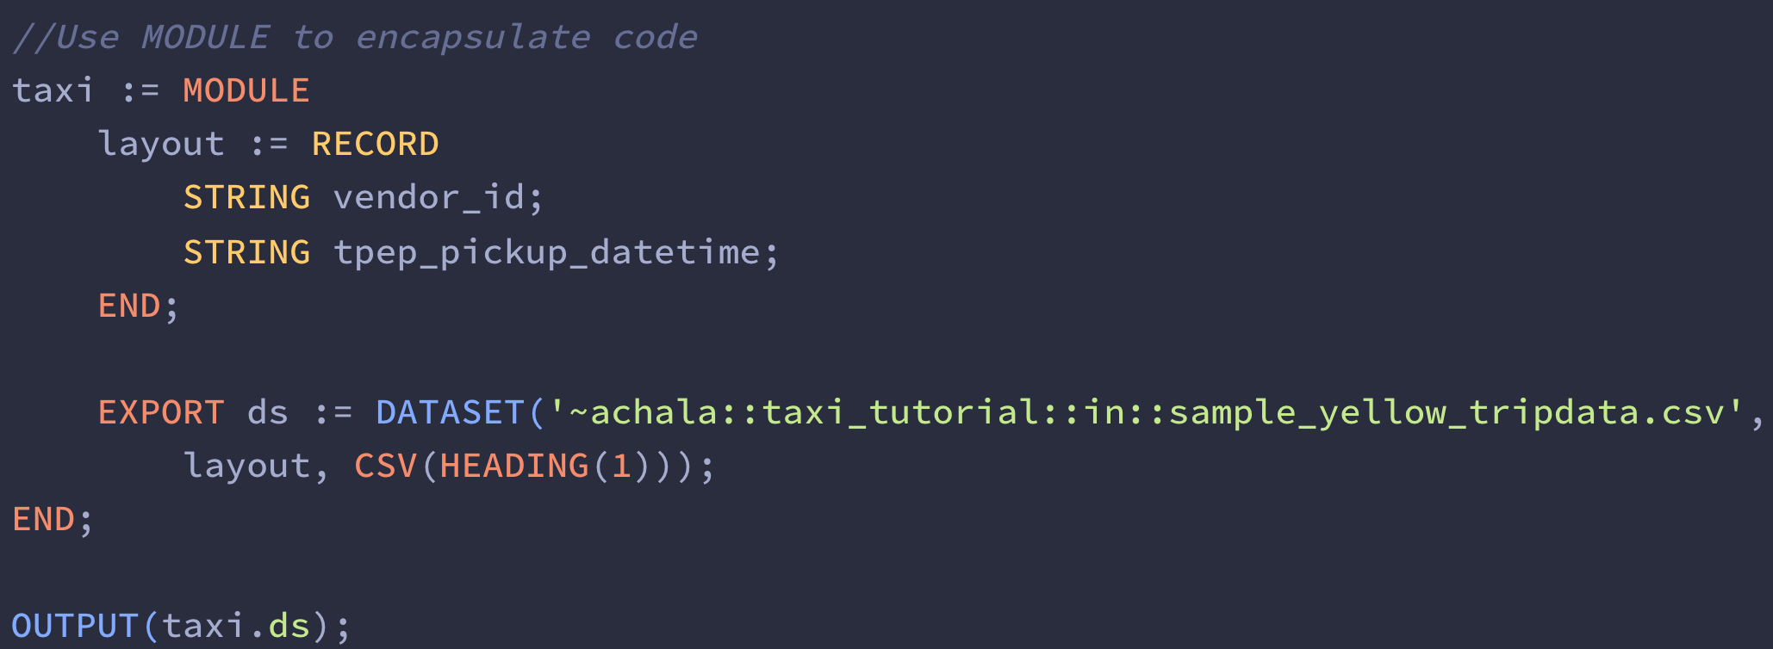
READ AND EXTRACT FIELDS (REUSABLE USING MODULE)
A MODULE definition encapsulates related code to promote reuse

Slide 41
Quick check – what have we learnt?
ECL is a Declarative programming language, optimized by the ECL Compiler to a Dataflow graph
An ECL program contains ACTIONS and DECLARATIONS
A DATASET represents a reference to data
A RECORD defines a layout of a DATASET
A MODULE encapsulates related code to promote reuse
A Workunit = execution metadata + output + code

Slide 42
Transform Data

Slide 43
The project Transform pattern
Source Dataset
Destination Dataset
Vendor ID (STRING) | Pickup Datetime (STRING)
----- | -------
----- | -------
----- | -------
Vendor ID (INTEGER) | Pickup Date (DATE) | Pickup Time (TIME) | Pickup Minutes After Midnight (INTEGER)
----- | ------- | ------- | ------
----- | ------- | ------- | ------
----- | ------- | ------- | ------
Transforms one source dataset to one destination dataset, where, for every source record exactly one destination record is produced.

Slide 44
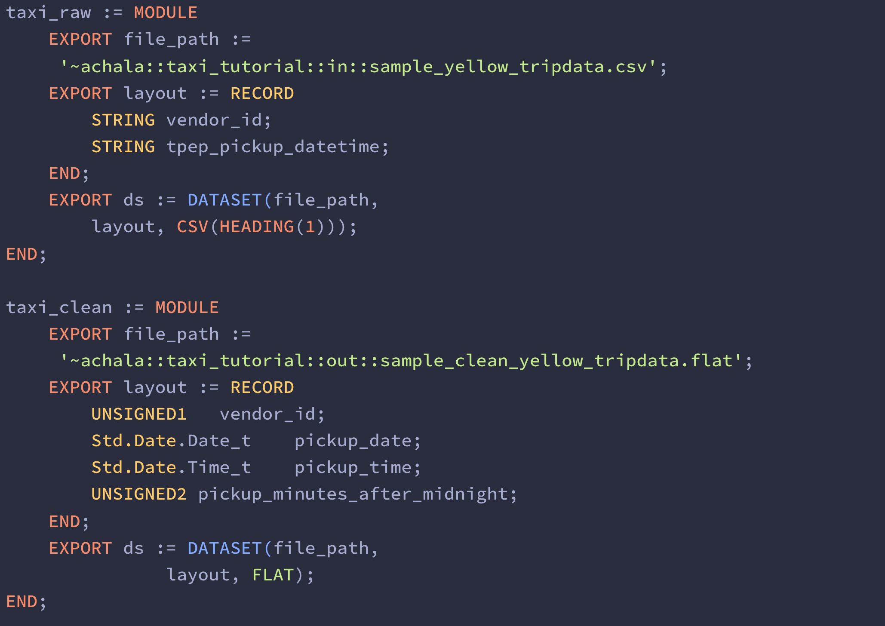

Source Schema
Destination Schema

Slide 45
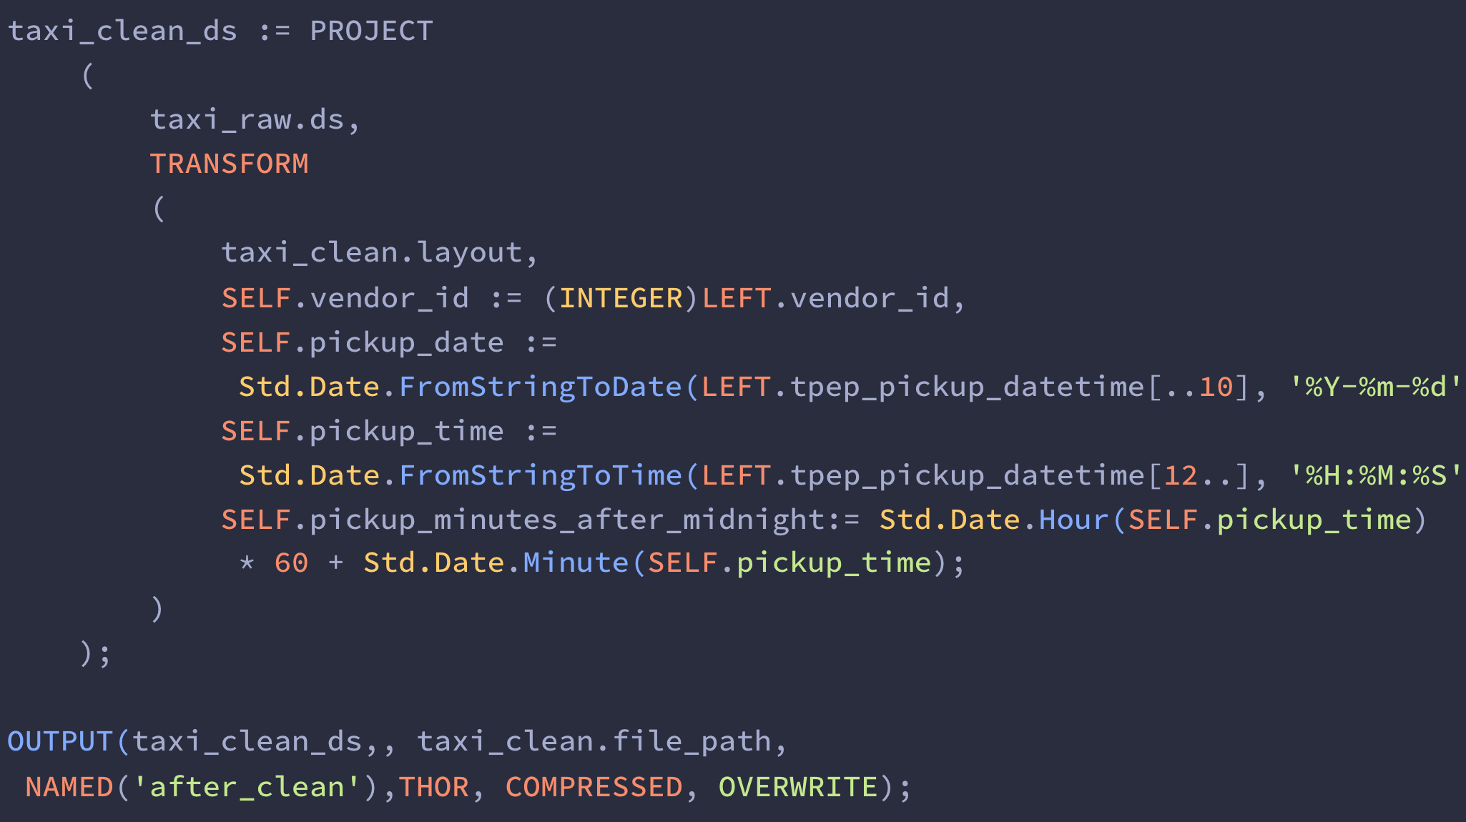
Apply Transformation

Slide 46
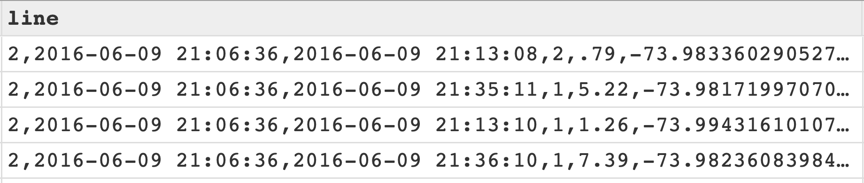
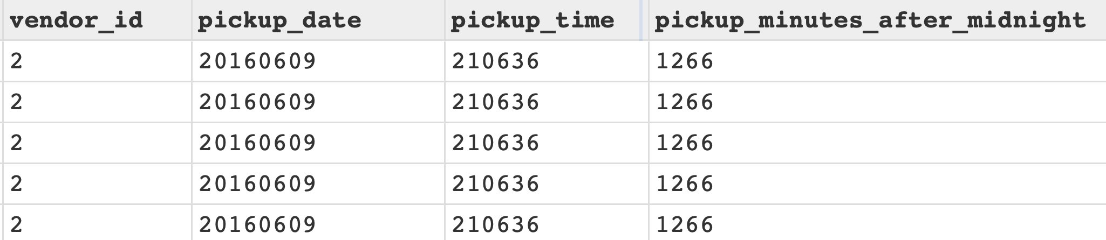
Input Data
Output Data

Slide 47
The join transform pattern
Vendor ID (INTEGER) | Pickup Date (DATE) | Pickup Time (TIME) | Pickup Minutes After Midnight (INTEGER)
----- | ------- | ------- | ------
----- | ------- | ------- | ------
Source Dataset 1
(e.g. Taxi Trip)
Vendor ID (INTEGER) | Pickup Date (DATE) | Pickup Time (TIME) | Pickup Minutes After Midnight (INTEGER) | Summary
----- | ------- | ------- | ------ | ------
----- | ------- | ------- | ------ | ------
JOIN
Destination Dataset
(e.g. Taxi Trip with Weather)
Date (DATE) | Minutes After Midnight (STRING) | Summary
----- | ------- | ------
----- | ------- | ------
Source Dataset 2
(e.g. Weather)

Slide 48
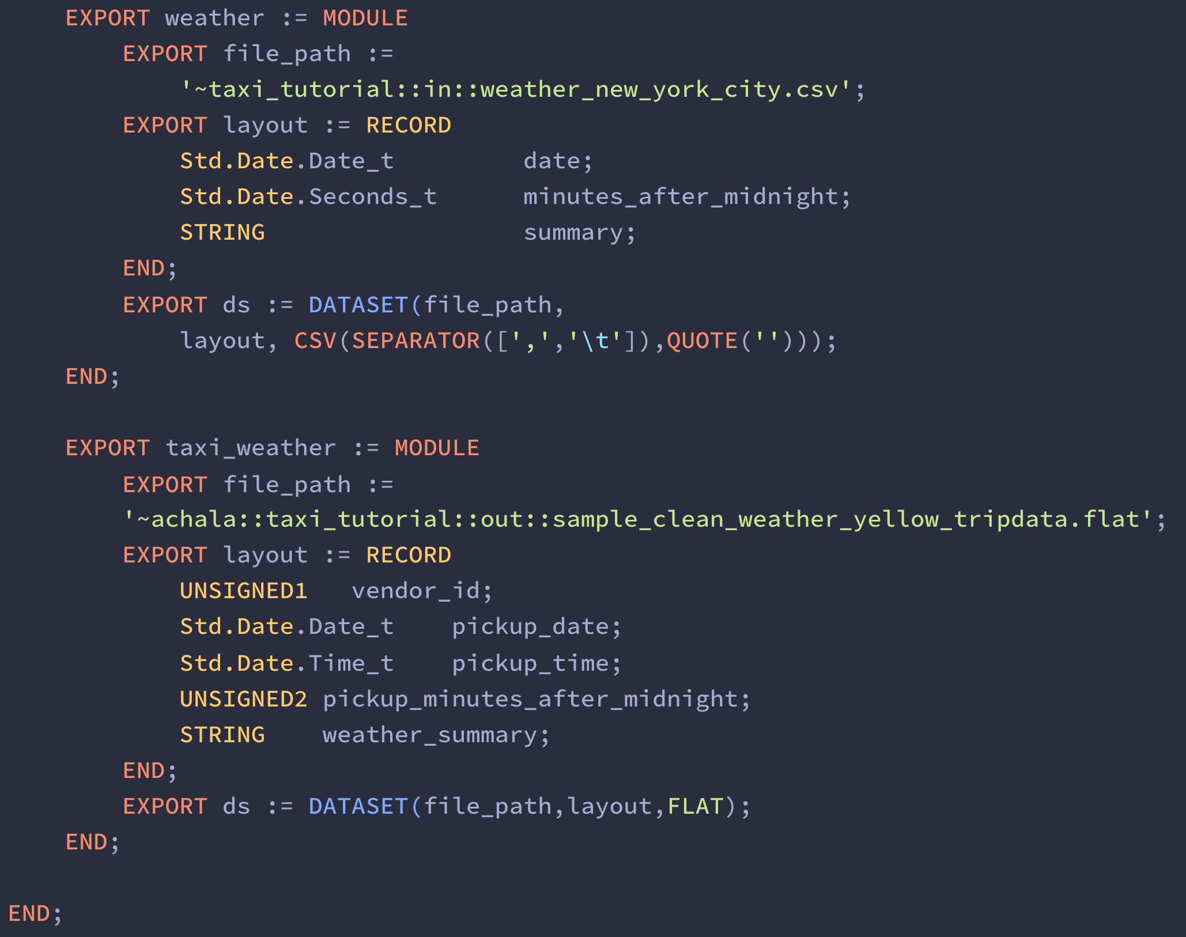

Source Schema 1
Source Schema 2

Slide 49
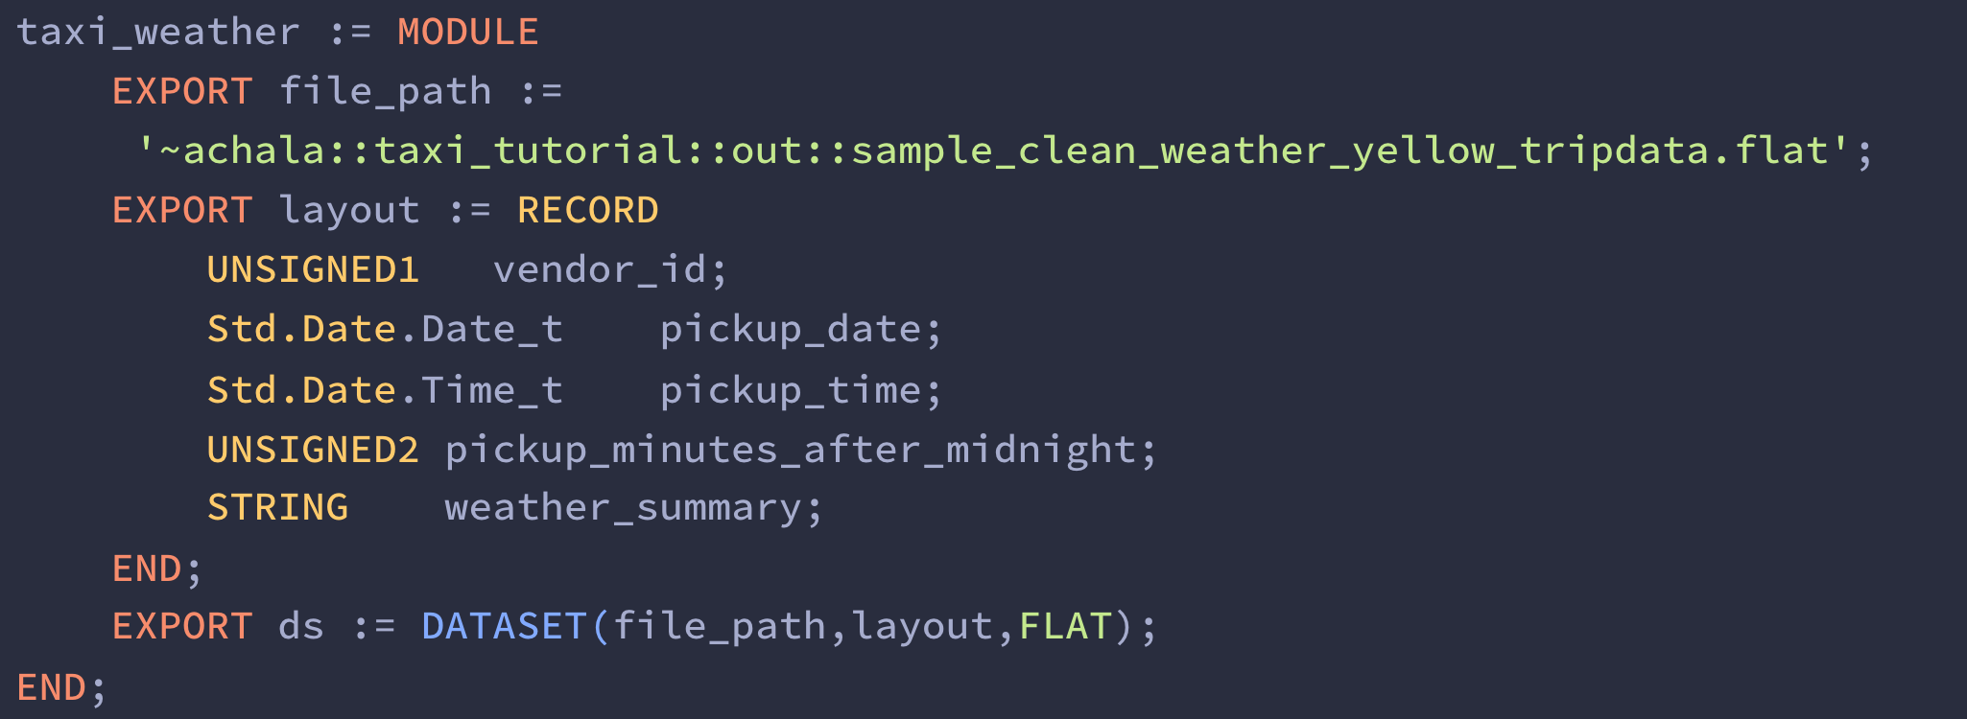
Destination Schema

Slide 50
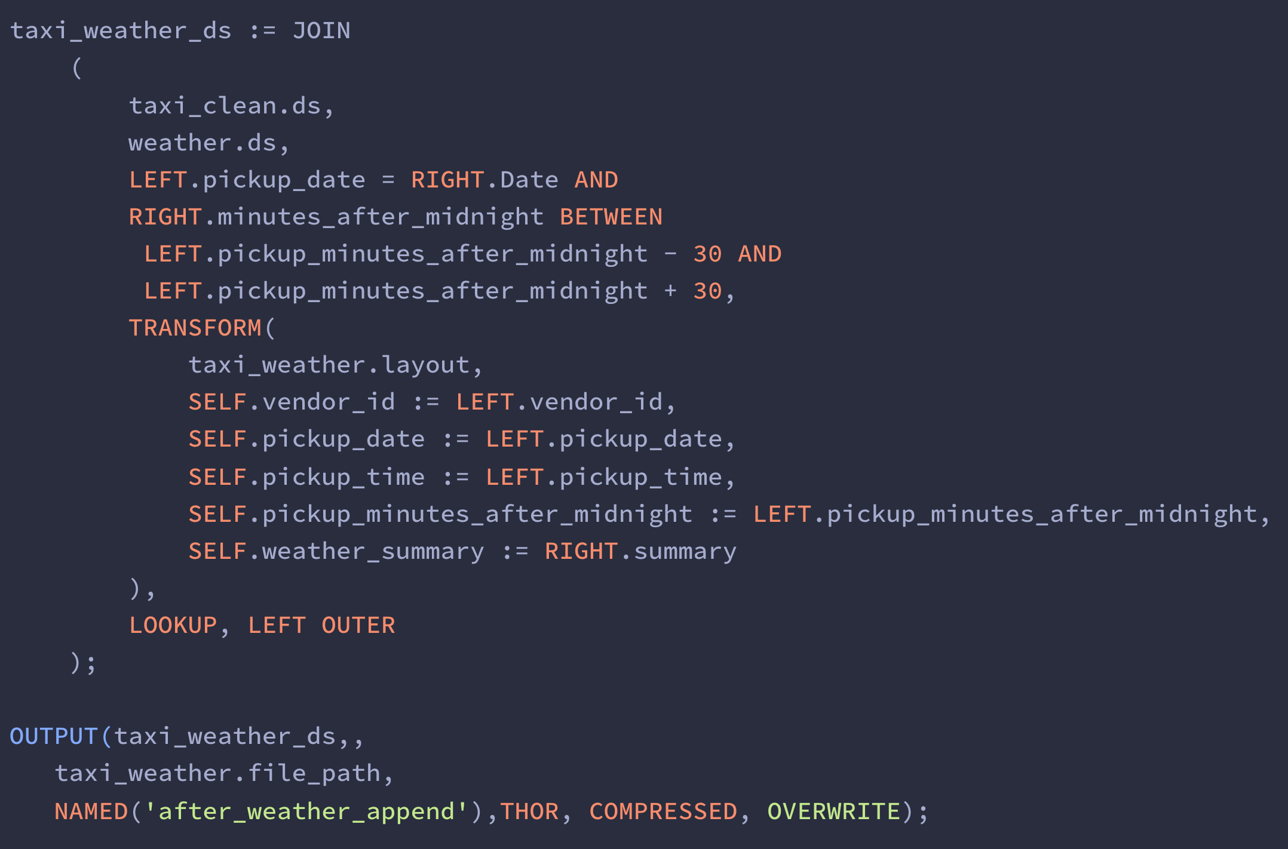
Apply Transformation

Slide 51
Quick check – what have we learnt?
Use the PROJECT function/pattern to transform a source record to a destination record using a single source dataset
Use the JOIN function/pattern to transform a source record to a destination record using more than one source datasets

Slide 52
EVEN more practice - The actual Data

Slide 53
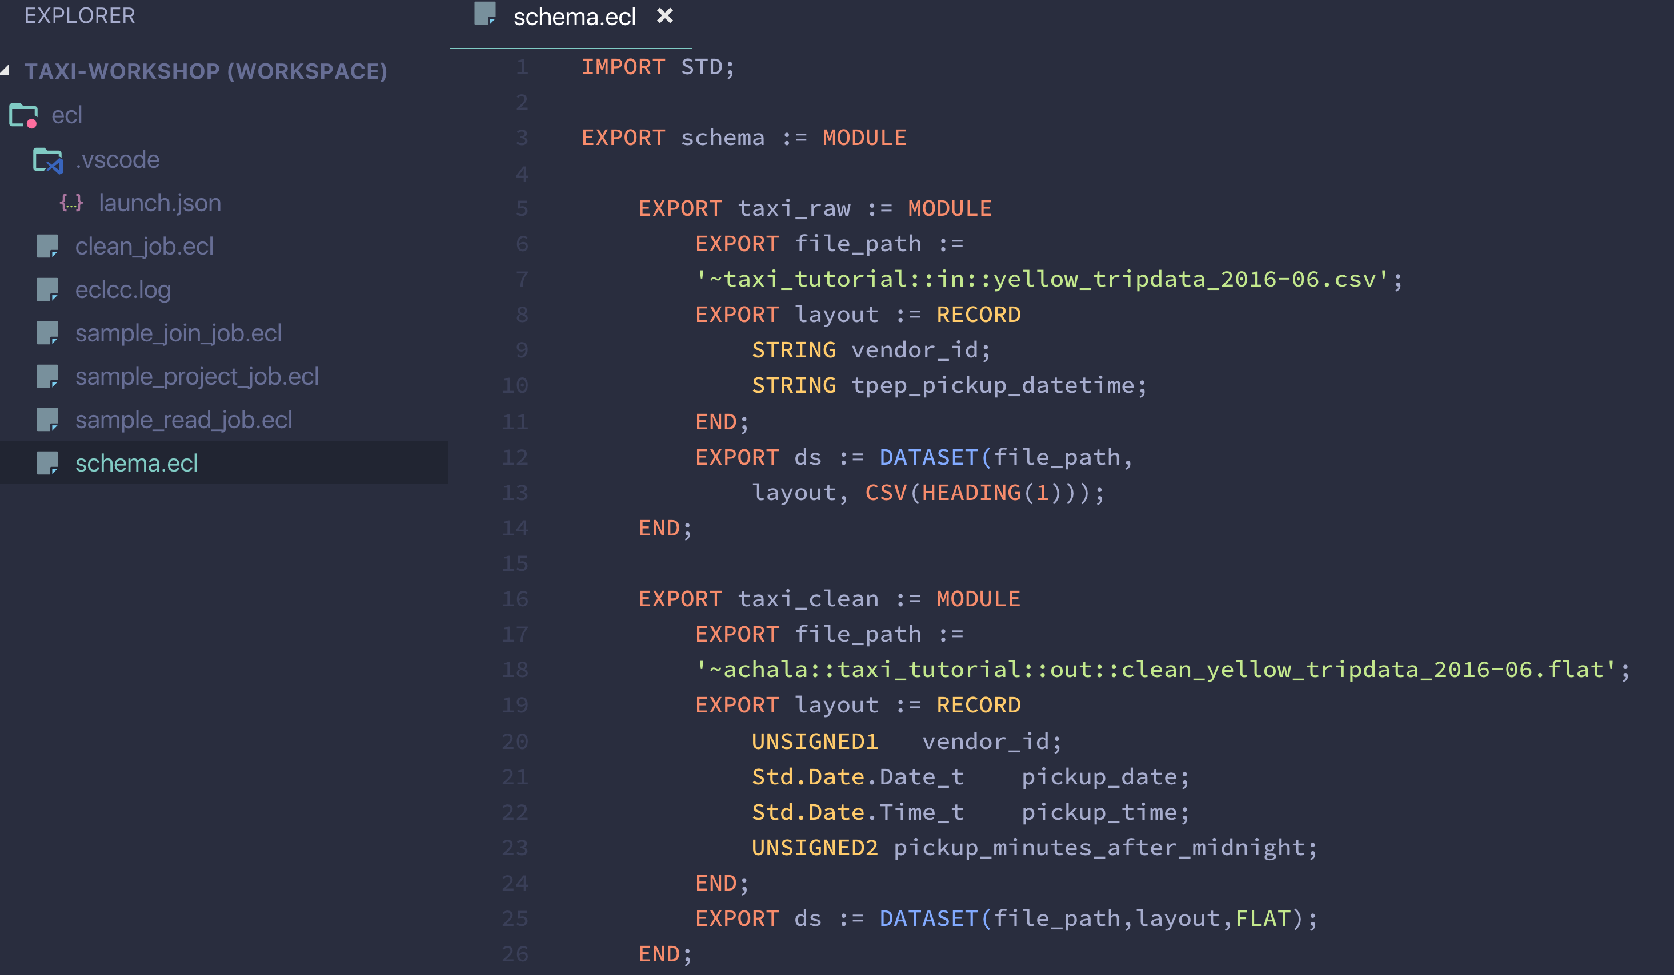
Some housekeeping
2. Change raw file name
1. Create schema.ecl to store ALL the schema definitions in a single module
2. Change clean file name

Slide 54
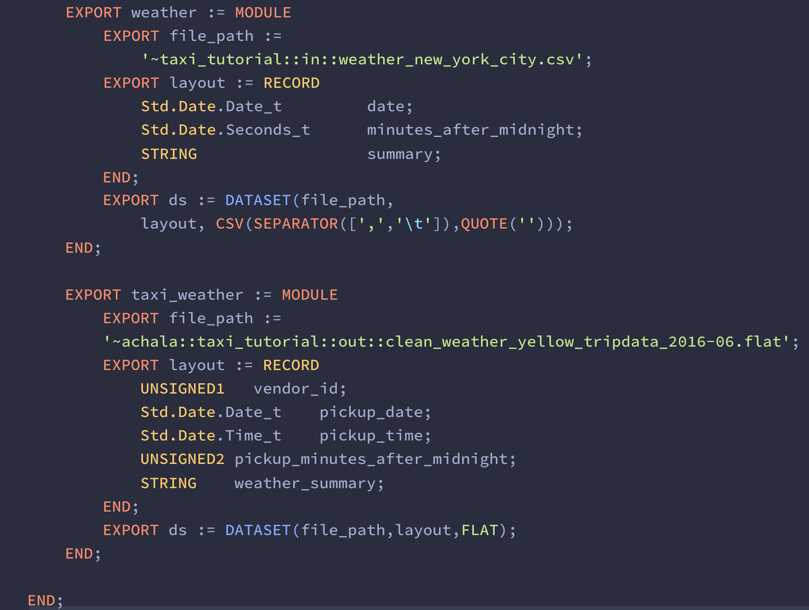

3. Change clean weather file name

Slide 55
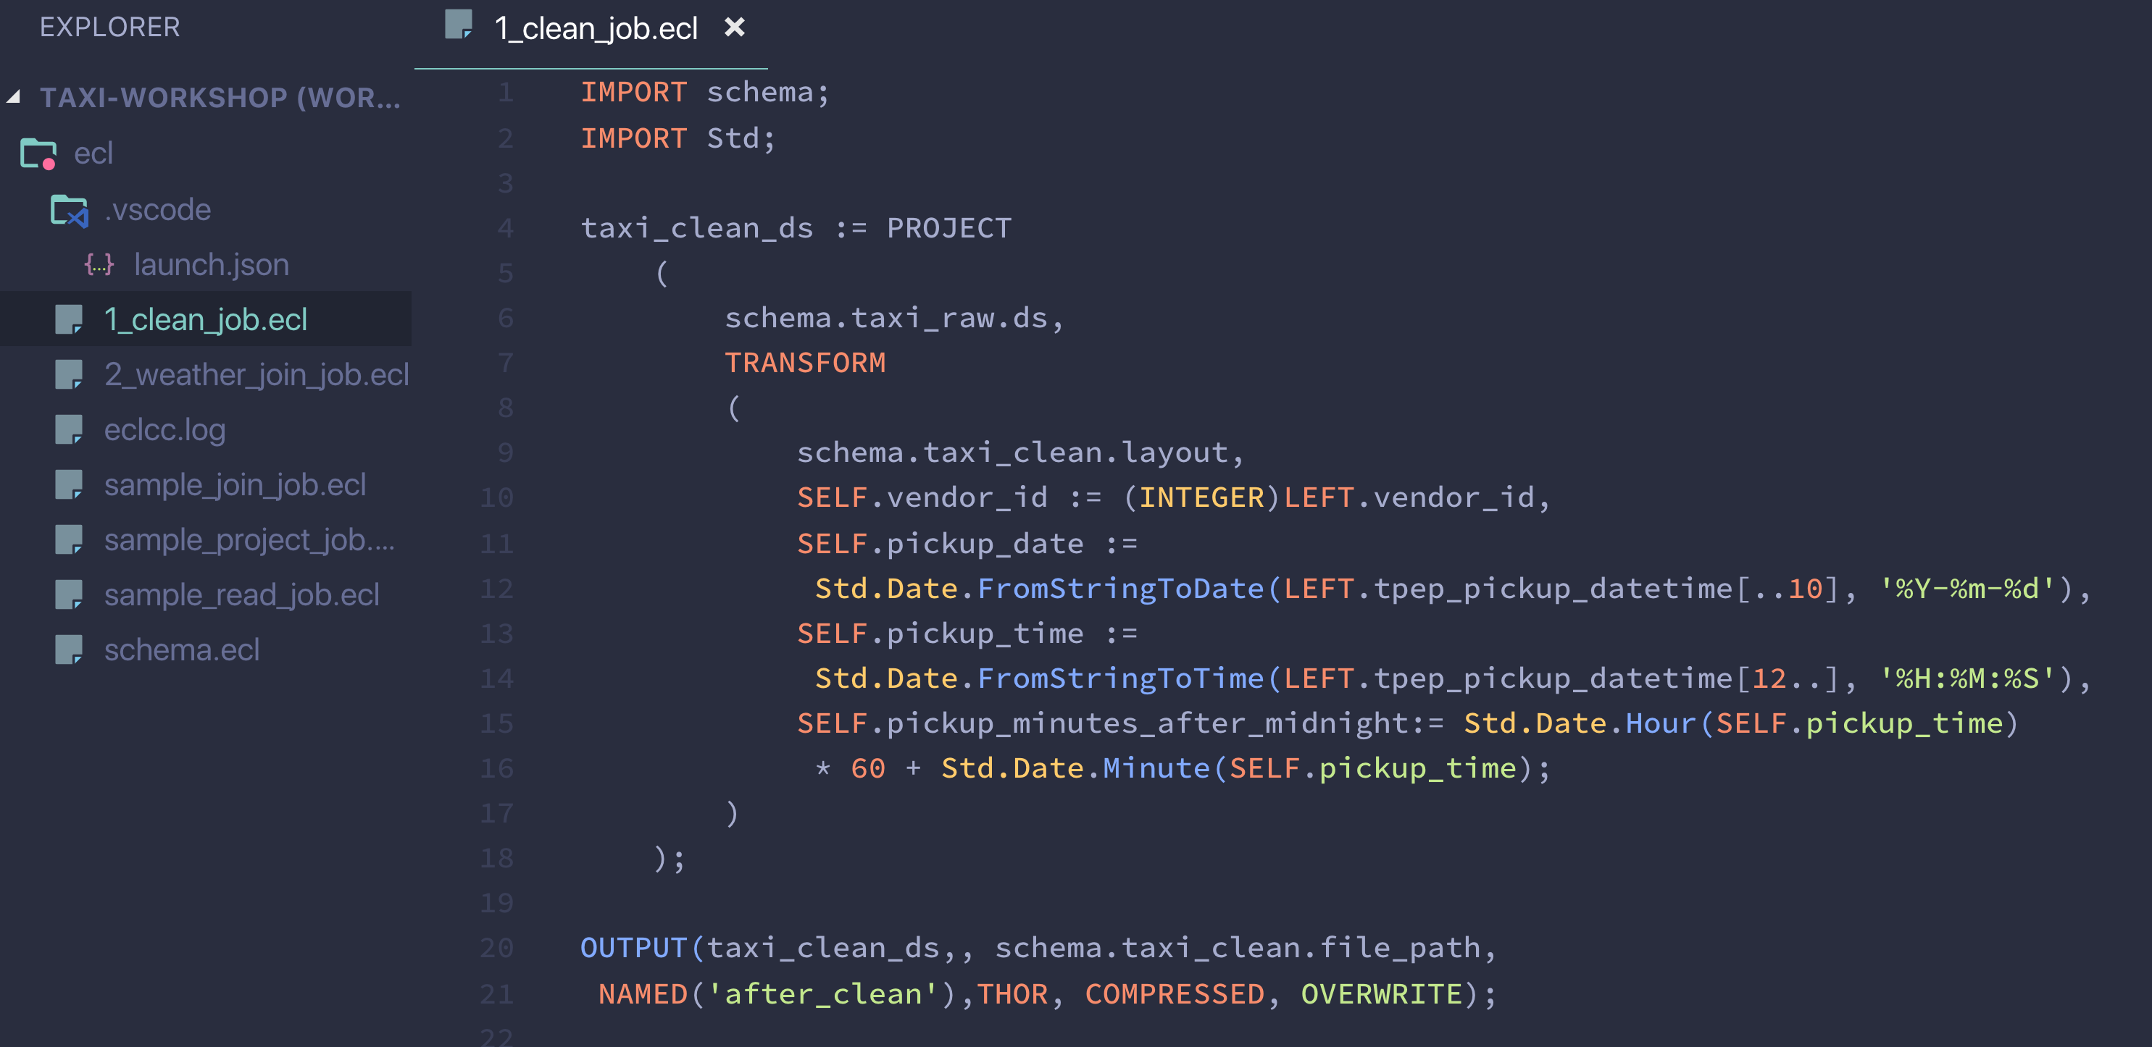
Use the PROJECT pattern to clean the data

Slide 56
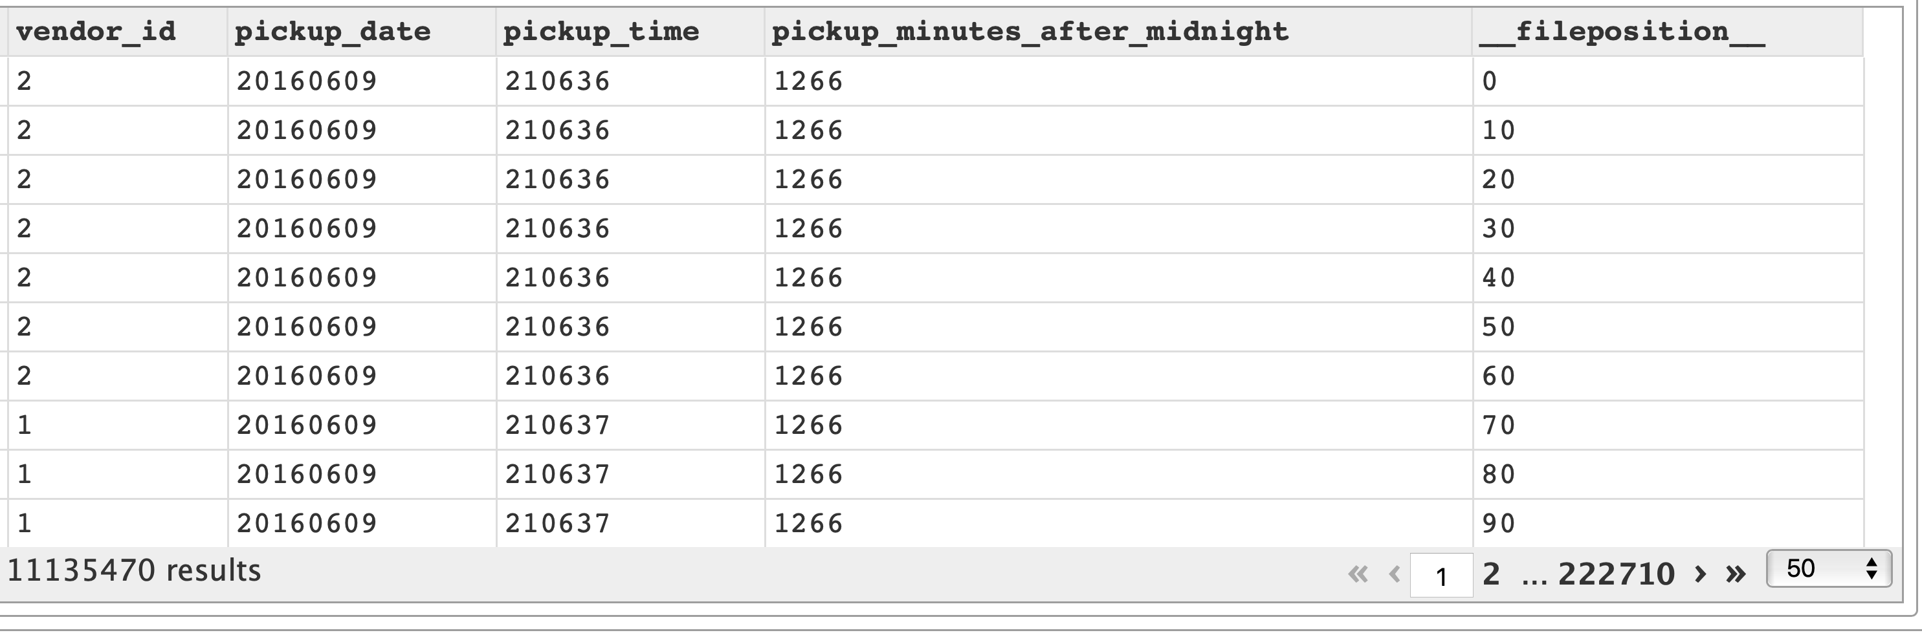
Output Data

Slide 57
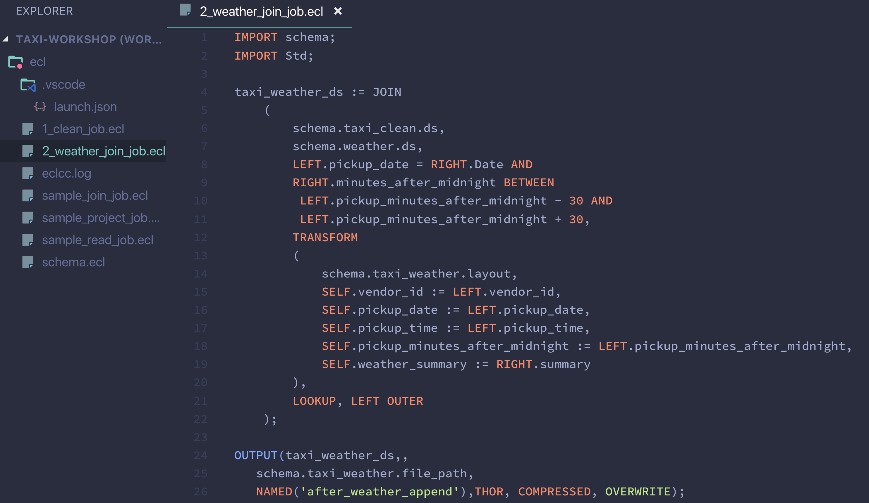
Use the JOIN pattern to APPEND weather DATA

Slide 58
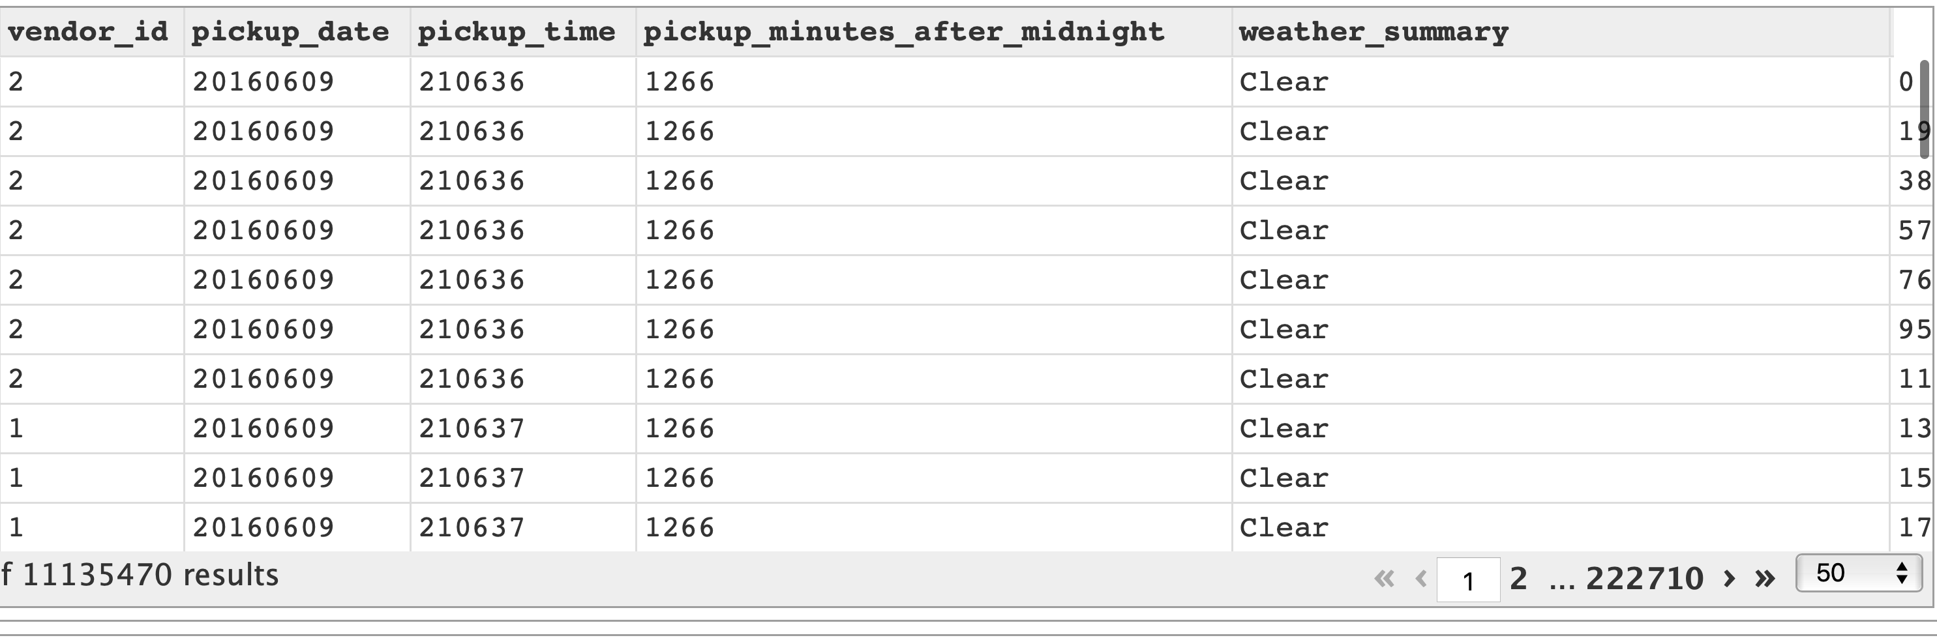
Output Data

Slide 59
Quick check – what have we learnt?
Organize the file schema’s for maximum reuse
Clean the real data (although only a few fields) and append time parameters
Append the cleaned data with the weather data

Slide 60
Why not consider all the fields in the trip data?

Slide 61

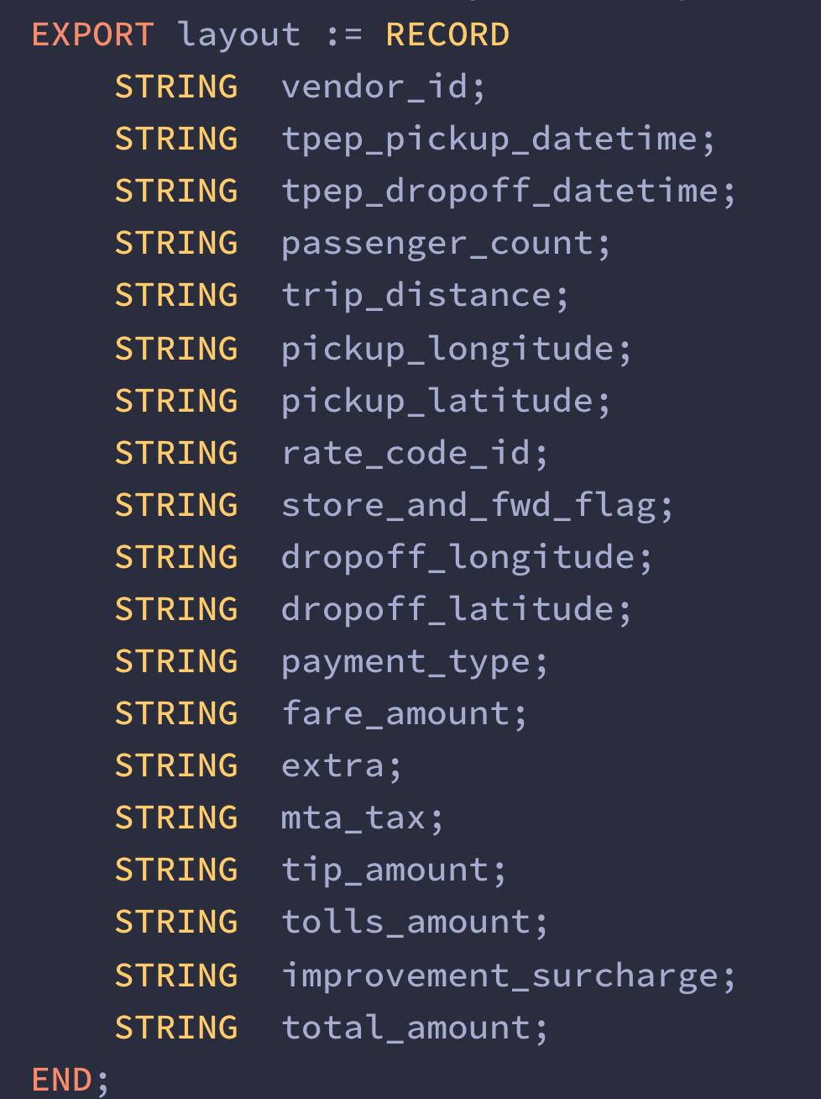
TAXI Raw file layout

Slide 62
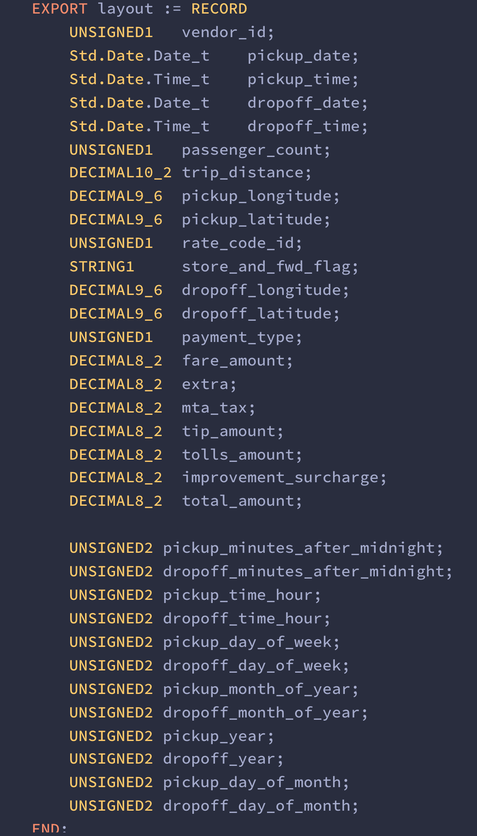
TAXI CLEAN file layout

Slide 63
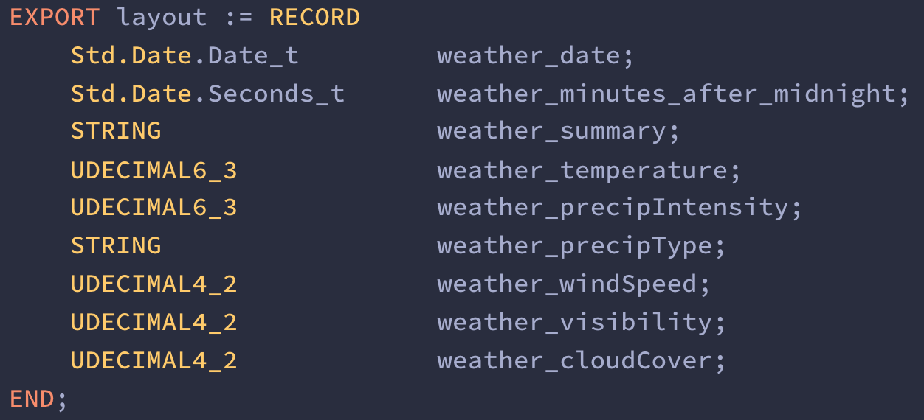
WEATHER CLEAN file layout

Slide 64
Problem statement
Modify the raw file schema to include all the fields
Run a test and validate that you can see all the fields
Modify the clean file schema to include the new fields
Run the clean job
Run the weather append job

Slide 65
AGGREGATION

Slide 66

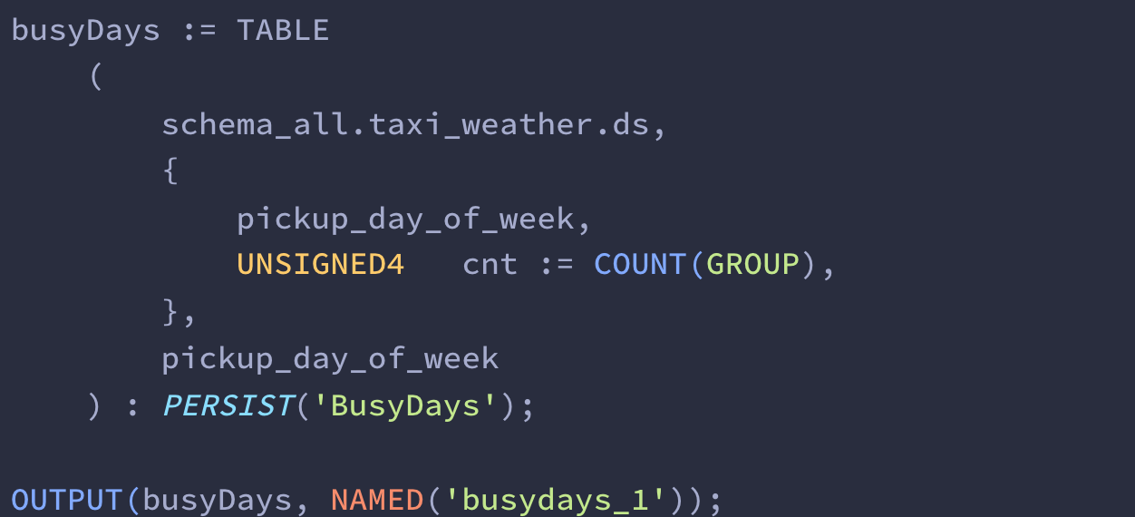
THE CROSS TAB (TABLE) Aggregation pattern
Measure (Field) of dataset to apply aggregation
Aggregation function
Group By Field
Persist the result to storage. If the input to aggregation is not changed and logic has not changed, the persisted data is automatically used the next time.

Slide 67
Quick check – what have we learnt?
TABLE function to accomplish the cross tab pattern
ECL works uniformly with small, big or complex data
Workflow states can be persisted using PERSIST to automatically recover from a certain point in the data workflow
Use the Visualize bundle to add visualizations to your output

Slide 68
Fine tuning your skills

Slide 69
Suggested next steps
Append Boroughs
Bronx, Queens, Manhattan, Brooklyn, Staten Island
What are the busiest boroughs?
What are the busiest months?
What is busiest hour of the day?
What is the correlation between a rainy day and trips?
Can we develop prediction models to detect trips provided month, day, hour, is raining?

Slide 70
Thank you!!!
http://hpccsystems.com
http://github.com/hpcc-systems/Train
Lili Xu - Lili.Xu@LexisNexisRisk.com
Arjuna Chala - Arjuna.Chala@LexisNexisRisk.com

